Slide 1

SOFTWARE ENGINEERING AND PROJECT MANAGEMENT (CSE 227)
Department of Computer Science and Engineering
School of Engineering,
PRESIDENCY UNIVERSITY

Slide 2
Requirement Analysis Data Modelling Class Modelling
Department of Computer Science and Engineering
School of Engineering, Presidency University

Slide 3
Module 2: Software Requirements and Design (9 hrs.) – Comprehension level
Requirements Engineering: Eliciting requirements, Functional and non- Functional requirements, SRS, Requirements modelling: Developing Use Cases, Developing Activity diagram and Swim lane diagram, Design : Design concepts, Architectural design, Component based design, User interface design.

Slide 4
Contents
Requirement Analysis
1.1 Objectives and Philosophy
1.2 Analysis Rule of Thumb
1.3 Domain Analysis
1.4 Requirements modelling approach
Scenario based Modelling
2.1 Creating Preliminary use case
2.2 Refining a preliminary use case
2.3 Writing a Formal use case
UML Models
3.1 Developing activity Diagram
3.2 Swim lane Diagram

Slide 5
Contents
Data Modelling concepts
4.1 Data objects
4.2 Data attributes
4.3 Relationships
Class- Based Modelling
5.1 Identifying Analysis classes
5.2 Specifying attributes
5.3 Defining operations
5.4 CRC Modelling
5.5 Associations and dependencies
5.6 Analysis and packages

Slide 6
1. What is Requirement Analysis?
Requirements analysis
specifies software’s operational characteristics
indicates software's interface with other system elements
establishes constraints that software must meet
Requirements analysis allows the software engineer (called an analyst or modeler in this role) to:
elaborate on basic requirements established during earlier requirement engineering tasks
build models that depict user scenarios, functional activities, problem classes and their relationships, system and class behavior, and the flow of data as it is transformed.

Slide 7
Requirement Analysis - A Bridge

Slide 8
1.1 Objectives and philosophy
To describe what the customer requires
To establish a basis for the creation of a software design
To define a set of requirements that can be validated once the software is built.

Slide 9
1.2 Rules of Thumb
The model should focus on requirements that are visible within the problem or business domain. The level of abstraction should be relatively high.
Each element of the analysis model should add to an overall understanding of software requirements and provide insight into the information domain, function and behavior of the system.
Delay consideration of infrastructure and other non-functional models until design.
Minimize coupling throughout the system.
Be certain that the analysis model provides value to all stakeholders.
Keep the model as simple as it can be.

Slide 10
1.3 Domain Analysis
Analysis is an attempt to build a model that describes the application domain
Software domain analysis is the identification, analysis, and specification of common requirements from a specific application domain, typically for reuse on multiple projects within that application domain
Object-oriented domain analysis is the identification, analysis, and specification of common, reusable capabilities within a specific application domain, in terms of common objects, classes, subassemblies, and frameworks

Slide 11
Domain Analysis
Define the domain to be investigated.
Collect a representative sample of applications in the domain.
Analyze each application in the sample.
Develop an analysis model for the objects.

Slide 12
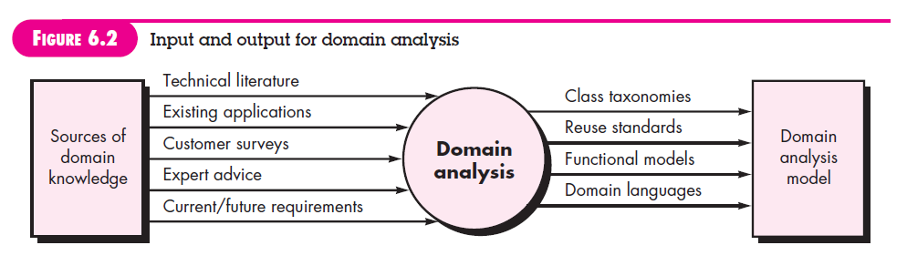
I/O for Domain Analysis

Slide 13
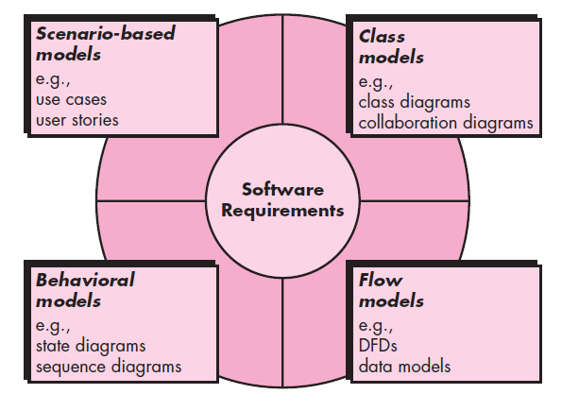
Elements of Requirement Analysis

Slide 14
2. Scenario-Based Models
“[Use-cases] a“[Use-cases] are simply an aid to defining what exists outside the system (actors) and what should be performed by the system (use-cases).” - Ivar Jacobson
Represented via use cases
2.1 Creating Preliminary use case
What to write about? – Inception and elicitation will provide the information for begin with use cases.
2.2 Refining Preliminary use case
2.3 Writing a formal use case

Slide 15
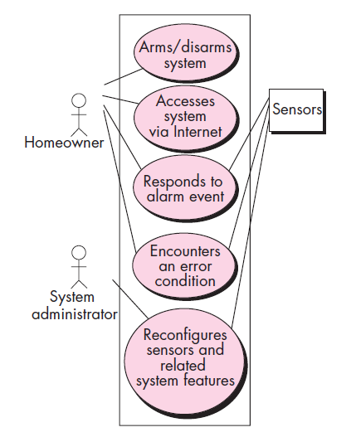
Scenario-Based Models
Use Case Diagram of Safe Home System

Slide 16
3. UML Models that supplement the Use Case
3.1. Activity Diagram
Supplements the use case by providing a graphical representation of the flow of interaction within a specific scenario.
3.2. Swimlane Diagram
Allows the modeler to represent the flow of activities described by the use-case and at the same time indicate which actor (if there are multiple actors involved in a specific use-case) has responsibility for the action described for an activity.

Slide 17
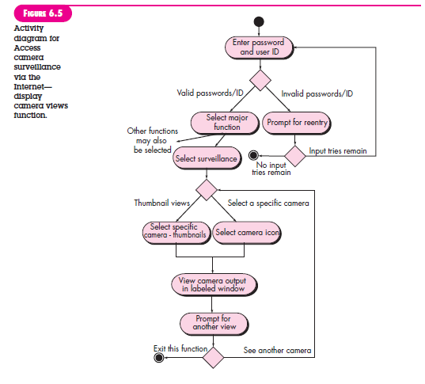
Activity Diagram

Slide 18
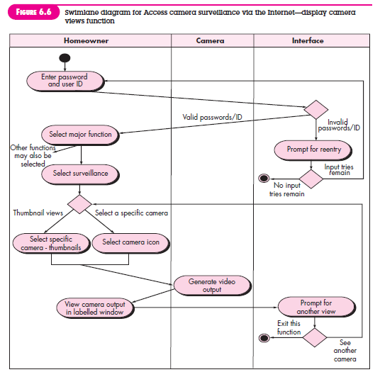
Swimlane Diagram

Slide 19
4. Data Modeling
Data modeling in software engineering is the process of creating a data model by applying formal data model descriptions using data modeling techniques. ... The data model will normally consist of entity types, attributes, relationships, integrity rules, and the definitions of those objects.
Examines data objects independently of processing
Focuses attention on the data domain
Creates a model at the customer’s level of abstraction
Indicates how data objects relate to one another

Slide 20
What is a Data Object
Can be an external entity (e.g., anything that produces or consumes information), a thing (e.g., a report or a display), an occurrence (e.g., a telephone call), an event (e.g., an alarm), a role (e.g., salesperson), an organizational unit (e.g., accounting department), a place (e.g., a warehouse), or a structure (e.g., a file).
The description of the data object incorporates the data object and all of its attributes.
A data object encapsulates data only - there is no reference within a data object to operations that act on the data.

Slide 21
Data Object and Attributes
A data object contains a set of attributes that act as an aspect, quality, characteristic, or descriptor of the object
object: Laptop
attributes:
model
color
price
diskspace
speed

Slide 22
Data Relationships
Data objects are connected to one another in different ways.
A cone Action is established between person and car because the two objects are related.
A person owns a car
person is insured to drive a car
The relationships owns and define the relevant connections between person and car.
Several instances of a relationship can exist
Objects can be related in many different ways

Slide 23
ERD
Entity relationship diagrams are used in software engineering during the planning stages of the software project. They help to identify different system elements and their relationships with each other. ... In the diagram, the information inside the oval shapes are attributes of a particular entity.

Slide 24
ERD Notation
Participation (At Least)
Cardinality (At Most)
One common form:
(0, m)
object
relationship
object
1
(1, 1)
2
attribute
Another common form:
object
relationship
object
1
2
(0, m)
(1, 1)
Multiplicity = Participation + Cardinality

Slide 25
Building an ERD
Level 1 - model all data objects (entities) and their “connections” to one another
Level 2 - model all entities and relationships
Level 3 - model all entities, relationships, and the attributes that provide further depth

Slide 26
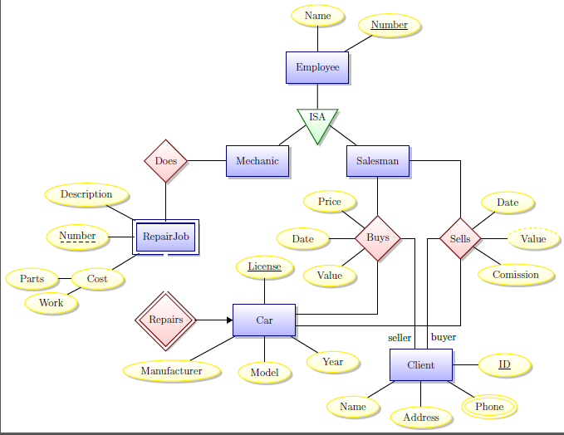
ERD – Example

Slide 27
Class-Based Modeling
Class-based modeling identifies classes, attributes and relationships that the system will use.
In the airline application example, the traveler/user and the boarding pass represent classes.
The traveler's first and last name, and travel document type represent attributes, characteristics that describe the traveler class.

Slide 28
Class-Based Modeling
The relationship between traveler and boarding pass classes is that the traveler must enter these details into the application in order to get the boarding pass, and that the boarding pass contains this information along with other details like the flight departure gate, seat number etc.

Slide 29
5. Class-Based Modeling
Class-based Modeling includes:
Identifying classes (often from use cases as a starting point)
Identifying associations between classes
Identifying general attributes and responsibilities of classes
Modeling interactions between classes
Modeling how individual objects change state -- helps identify operations
Checking the model against requirements, making adjustments, iterating through the process more than once

Slide 30
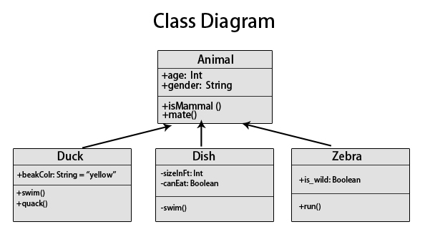

Slide 31
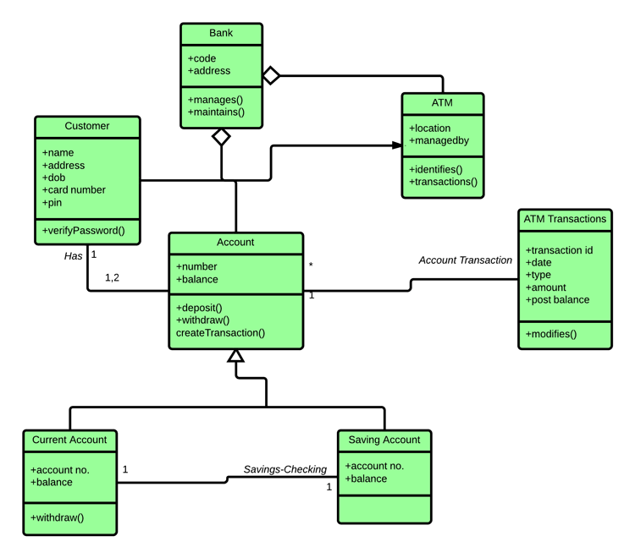

Slide 32
Identifying Analysis Classes
There are two ways to identify classes:
Natural Language Analysis Method (based on parts of speech)
CRC cards
In Natural Language Analysis method, we map parts of speech to object model components:
Nouns usually map to classes, objects, or attributes
Verbs usually map to operations or associations

Slide 33
Natural Language Analysis method
Part of speech | model component | Examples
Proper noun | Instance (object) | Alice, Ace of Hearts
Common noun | Class (or attribute) | Field Officer, PlayingCard, value
Doing verb | Operation | Creates, submits, shuffles
Being verb | Inheritance | Is a kind of, is one of either
Having verb | Aggregation/Composition | Has, consists of, includes
Modal verb | Constraint | Must be
Adjective | Helps identify an attribute | a yellow ball (i.e. color)

Slide 34
Natural Language Analysis method
Categories of Classes:
Entity class -- these represent persistent information tracked by a system. This is the closest parallel to "real world" objects.
Boundary class -- these represent interactions between user and system. (For instance, a button, a form, a display)
Control class -- usually set up to manage a given usage of the system. Often represent the control of some activity performed by a system

Slide 35
Entity Class
Also called as “Model” or “Business” classes
Terms that are domain-specific in use cases
Recurring nouns
Real-world entities and activities tracked by system
They correspond to “Database Table”
Examples of entity classes are:
Employee
Student
Field Officer

Slide 36
Boundary Class
Identify general user interface controls that initiate a use case
Identify forms or windows for entering data into a system
Identify messages used by system to respond to a user
Examples of boundary classes are:
Student Attendance Report
Employee Details Capture Form

Slide 37
Finding Controller Class
Creation or update of entity objects
Instantiation of boundary objects as they obtain information from entity objects
Complex communication between sets of objects
Validation of data communicated between objects or between the user and the application.
Examples of controller classes are:
Product Controller in a Product automation system
Home Controller in a Home automation system

Slide 38
Natural Language Analysis method Applicability
Natural Language Analysis Method is used in:
J2EE: Front-Controller
JSP-Servlets programming
Swing applications
Spring Framework
C# .NET: Page-Controller
MVC (Model-View-Controller) applications
Windows Forms applications
Web Applications

Slide 39
The CRC stands for Class-Responsibility-Collaborator.
It provides a simple method for identifying and organizing the classes that are applicable to the system or product requirement.
Class is an object-oriented class name. It consists of information about sub classes and super class
Responsibilities are the attributes and operations that are related to the class.
Collaborations are identified and determined when a class can achieve each responsibility of it. If the class cannot identify itself, then it needs to interact with another class.

Slide 40
CRC Cards
CRC (Class-Responsibility-Collaborator) modeling provides a mean for identifying and organizing the classes that are relevant to the system.
CRC Layout:

Slide 41
CRC Cards - Class
Class:
Represents a type of object being modeled
One card per class
Can represent an entity class, boundary class or controller class

Slide 42
CRC Cards - Responsibility
System intelligence should be distributed across classes to best address the needs of the problem
Each responsibility should be stated as generally as possible
Information and the behavior related to it should reside within the same class
Information about one thing should be localized with a single class, not distributed across multiple classes.
Responsibilities should be shared among related classes, when appropriate.

Slide 43
CRC Cards - Collaborations
Classes fulfill their responsibilities in one of two ways:
A class can use its own operations to manipulate its own attributes, thereby fulfilling a particular responsibility, or
a class can collaborate with other classes.
Collaborations identify relationships between classes
Collaborations are identified by determining whether a class can fulfill each responsibility itself
Three different generic relationships between classes
the is-part-of relationship
the has-knowledge-of relationship
the depends-upon relationship

Slide 44
CRC Card Session
The general process:
Start with a scenario (usually representing a normal course through a use case)
Identify initial classes/objects and make cards for them (this is can often be done by picking out the nouns)
Going through a scenario helps identify responsibilities of a chosen object
Identify collaborations between objects that have been created
Sometimes, we'll identify a collaboration with a new object type that doesn't have a card yet -- this helps discover new classes
When new classes are created, walk through scenarios again to discover any new responsibilities and collaborators (it's an iterative process)
More use cases/scenarios will yield more classes, responsibilities, and collaborators

Slide 45
CRC Card Session
Finding responsibilities
Look for verbs in the scenario descriptions. These often tell us what an object does
Also ask what the class knows. This tells us what an object needs to store. Sometimes a primary responsibility of a class is management of certain unique information
Finding collaborators
If a class has a responsibility that required it to get, or modify, information it doesn't have on its own, it will need to collaborate with another class
Most often, one class specifically initiates the collaboration
Usually, the collaboration is a request for information or a request to do something
The initiator's card should list the helper class as a collaborator
In this case, the initiator class depends on the collaborator class to accomplish its tasks

